Slide 1
University Campus Equipment Rental System (UCERS)
CS489 Professor: Obinna
Tao Wu (614164)
2023-11-04
2023

Slide 2
CONTENTS
Part 01
Part 02
01
02
Introduction & Problem Scenario
System Requirements
Part 03
Part 04
03
04
Domain Model
Database Design
Part 05
05
Demo the Software Solution

Slide 3
1
Introduction & Problem Scenario
PART

Slide 4
Problem:
Existing manual process not scalable with increasing student population.
Need for digital transformation.

Slide 5
2
System Requirements
PART

Slide 6
System Requirements
Member Registration using valid university IDs.
Digital Equipment Check-in and Check-out by ERD staff.
Search equipment in the database.
Manage manufacturer information.
Use-cases/User Stories:

Slide 7
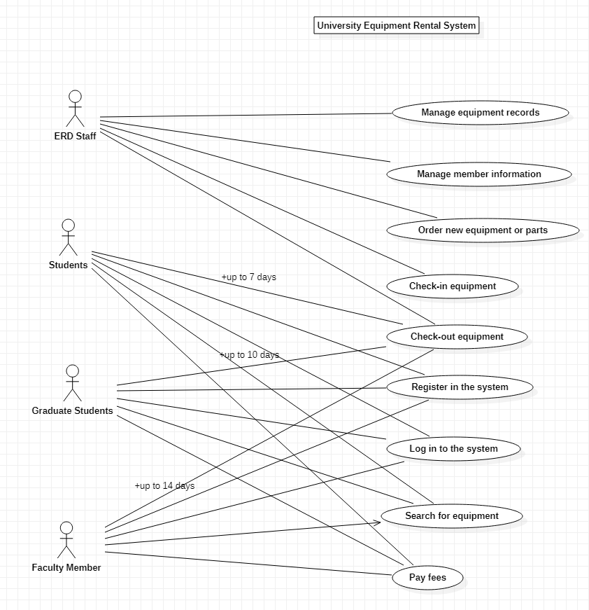

Slide 8
3
Domain Model
PART

Slide 9
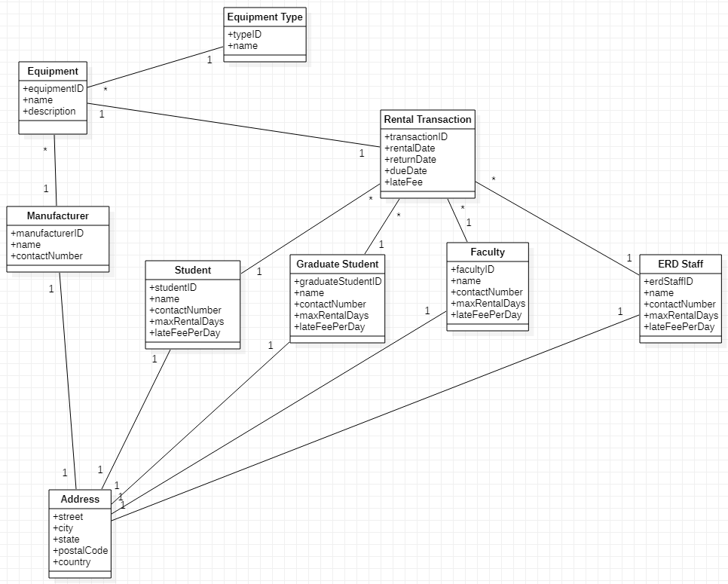
Domain Model
Class Diagram:

Slide 10
4
Database Design
PART

Slide 11
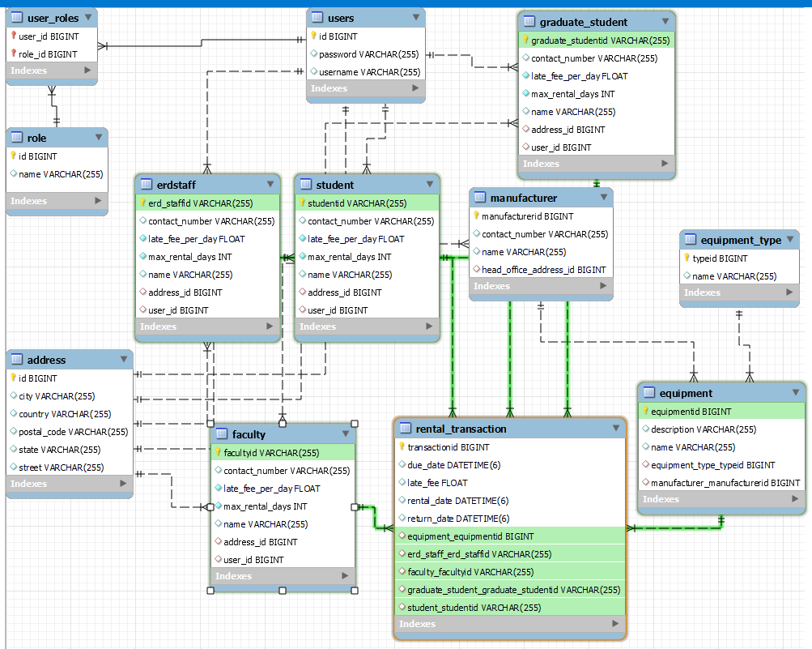
Database Design
E-R Diagram:

Slide 12
5
Demo the Software Solution
PART

Slide 13
Tech Stack:
Backend: Spring Boot,security,Junit,git
Database: MySQL
Deployment & Hosting: Azure

Slide 14
THANKS
THE END
2023

